Slide 1

Introduction to Data Science with Python
Mahmoud Mabrouk

Slide 2
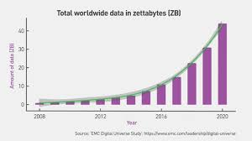
The Data Explosion
Notes:
At the end data science is not really a new field of study, like chemistry for example. It was a result of an event: The data explosion
Wherever you go, you find a crazy amount of data: Web tracking (business decision making), information about customers, biological, weather, even sports...
There is a need for a new profession that can use all the tools to generate insights from the data

Slide 3
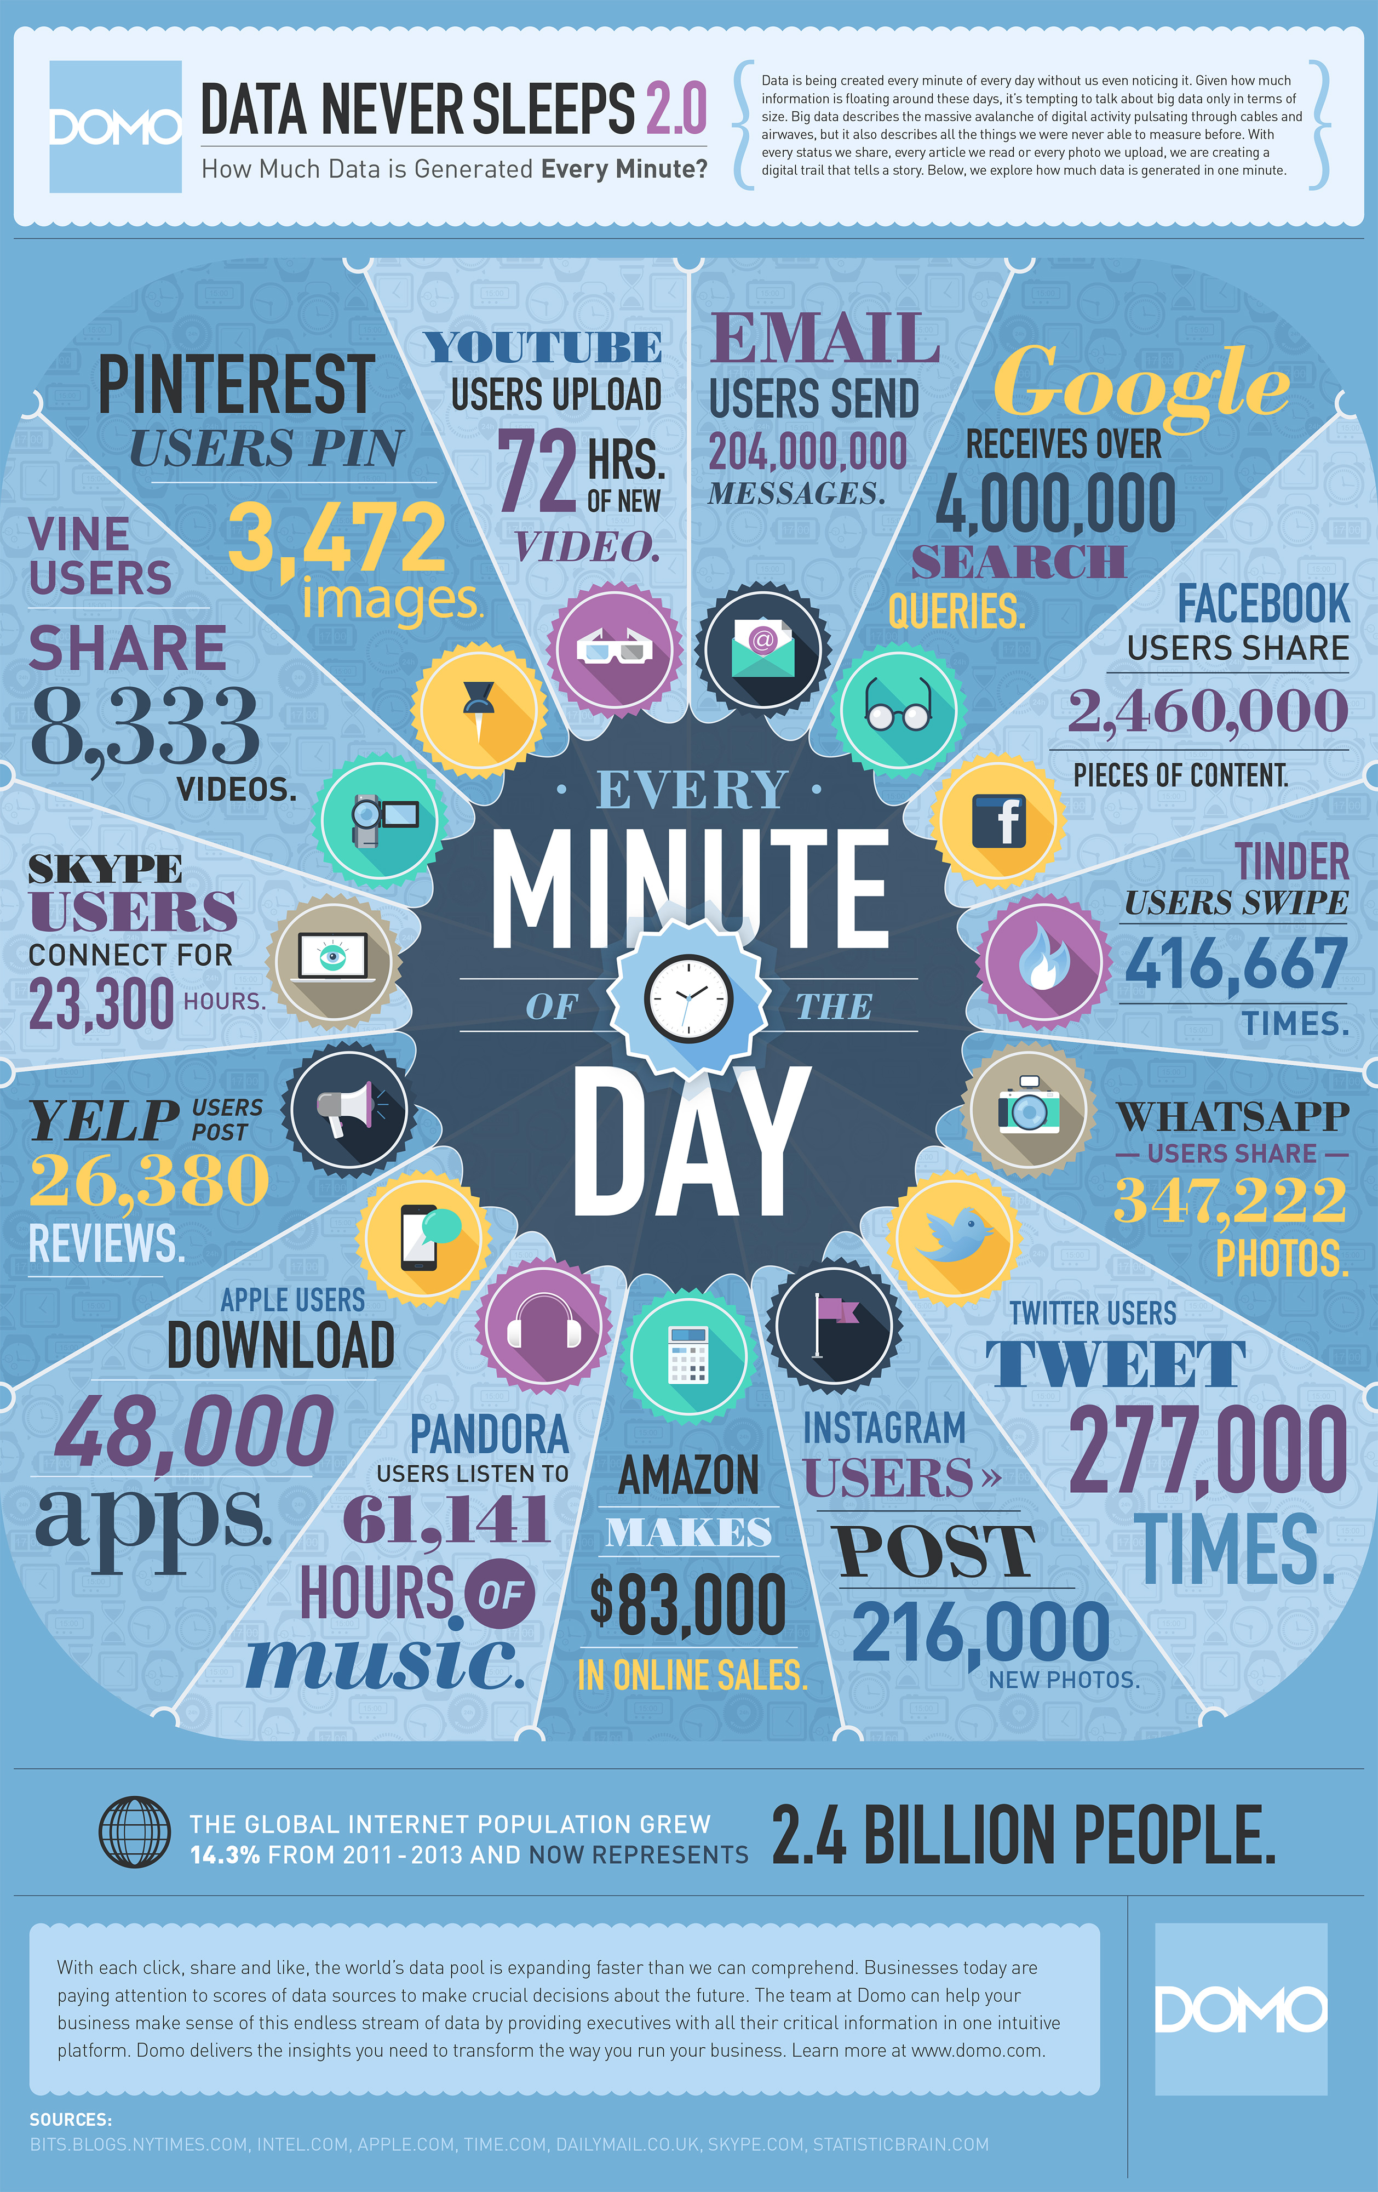

Slide 4
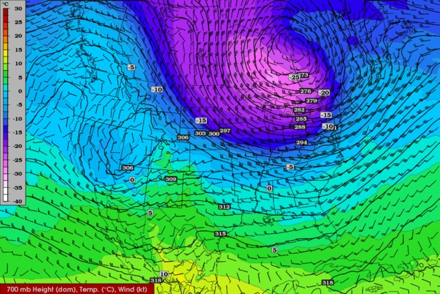

Slide 5
Applications

Slide 6

Notes:
Personalization of Movie Recommendations
Auto-Generation and Personalization of Thumbnails / Artwork
Location Scouting for Movie Production
Streaming Quality

Slide 7


Notes:
Obama raised 1 billion using this technology
Tried submitting emails using different subject lines and variations. Discovered that emails signed by his wife were the most successful
Used reddit for Q&A sessions because data showed that their followers are there
Selected unconventional media to reach people

Slide 8


Slide 9
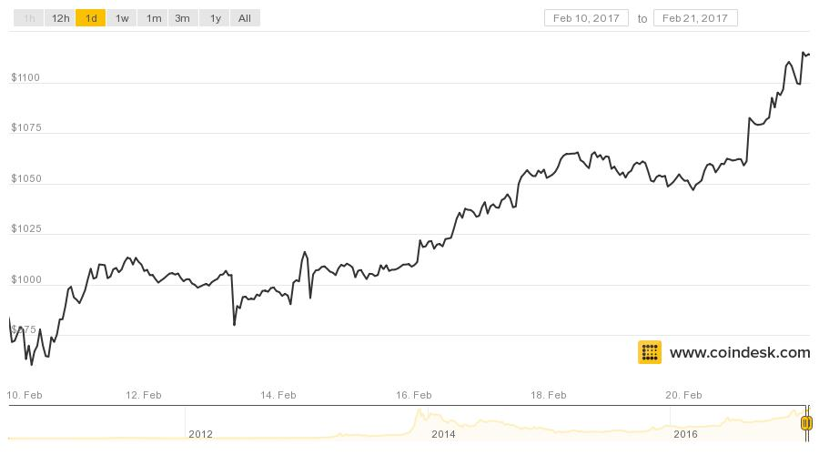
Finance

Slide 10
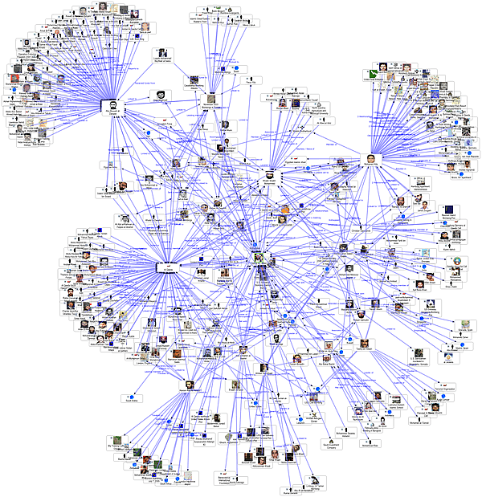
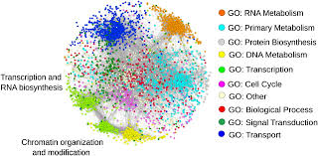

Slide 11
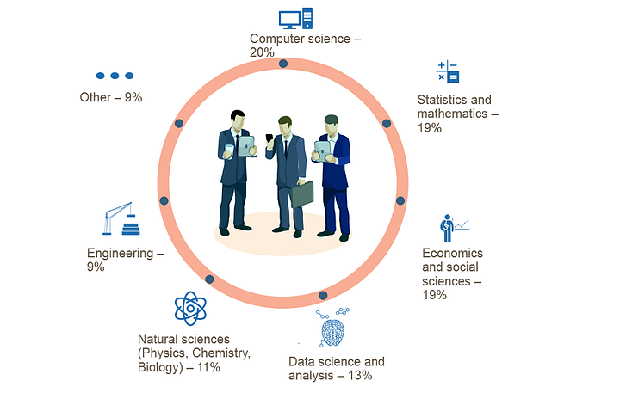
Who Are Data Scientists?

Slide 12
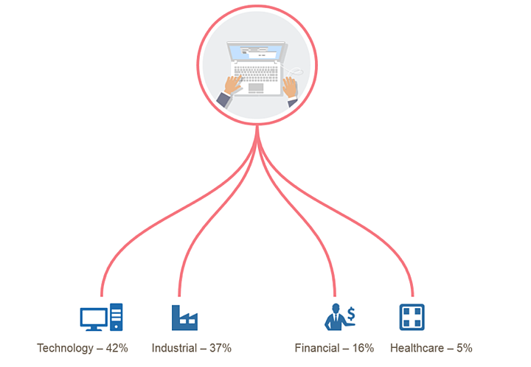
Which industries are hiring Data Scientists?

Slide 13
Data Science is Sexy
Median salary (in the US):
Up to 3 years: 80k $
4 to 8 years 120k $
9+ years: 150k $
Source: Burtch Works
Salaries in Germany: 40k-80k €
Source: Payscale.com

Slide 14
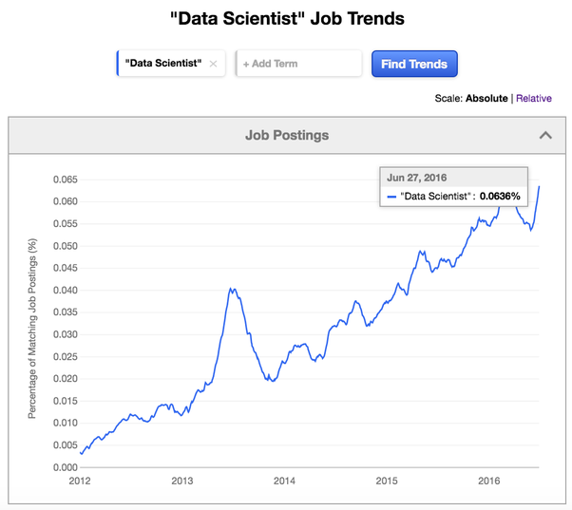

Slide 15
Back to our question: What is Data Science?

Slide 16
Domain Knowledge
Hacking and Coding
Machine Learning and Statistics

Slide 17
Domain Knowledge
What is the problem you are trying to solve?
What is the right metric?
Communicate with a non -technical audience
What actions should be undertaken?

Slide 18
Hacking and Coding
Cleaning data
Preprocessing data
Scripting
Bash
SQL
Writing pipelines
Testing
Data Visualisation

Slide 19
Machine Learning and Statistics
Statistical packages
Advanced Math
Experiment design
Model fitting
Model validation
Machine Learning Packages

Slide 20
What is Data Science?
"Data Scientist(n.): Person who is better at statistics than any software engineer and better at software engineering than any statistician."
Data Science = Coding + Statistics + Machine Learning + Domain knowledge

Slide 21
Machine Learning
Machine Learning is concerned with the development of algorithms and techniques that allow computers to learn

Slide 22
The Data Science Process
Collect Raw Data
Process Data
Clean Data
Explore Data
Create Models and Algorithms
Communicate Results through visualizations
Create Data Products

Slide 23
Data Collection
Web scrapping
Sensors
Experiments
API
...

Slide 24
Data Cleaning
Bad format
Deal with missing data
Ignore useless variables
Wrong data, for example deliberate lies from users

Slide 25
Data Processing
Transform variables (data formats, string to float)
Derive variables (e.g. country from IP)
Normalize strings
Normalize features (scale everything to 0-1 with variance 0-1)
Enrich data
Merge different columns into groups
...

Slide 26
Data Exploration
Define hypothesis or questions
Plot the data
Find dependencies between fields: Calculate correlation, dimensionality reduction, cluster data

Slide 27
Data Modeling
What is the right problem? Clustering, Regression..
Feature engineering: finding the right features that leads to the simplest decision algorithm
Selecting the right algorithm
Select the right metric
Assessing the results

Slide 28
Parts of a Data Science Project
Data Collection (scrapping the web, sensors, biological experiments, financial data...)
Data Engineering (Storage of data, design of APIs, Databases, data management)
Data Preprocessing, cleaning
Data Analysis (What we will do most)
Presentation (Arguing for some results for a non-expert audience)
Deployment: Deploying some models for other to use

Slide 29
Parts of a Data Science Project
Data Collection (scrapping the web, sensors, biological experiments, financial data...)
Data Engineering (Storage of data, design of APIs, Databases, data management) --> Done by data engineer
Data Preprocessing, cleaning
Data Analysis (What we will do most)
Presentation (Arguing for some results for a non-expert audience)
Deployment: Deploying some models for other to use --> Done by developers

Slide 30
The Data Engineer
Build scalable systems for storage of data
Works mostly with Big Data
Use systems like Amazon Web Services (AWS, Hadoop=
Design databases, algorithms for distributed processing
Bad data design makes our job very much difficult
Garbage in Garbage out

Slide 31
Getting Data
Kaggle
Web scrapping
Government Data data.gov
NYC Open Data (link)

Slide 32
Kaggle

Slide 33
Common Software
Access: SQL, Hadoop, MS SQL Server, Spark
Hacking: Python, Perl
Visualization: matplotlib, Tableau, Javascript+D3.js
Statistical analysis: SAS, R, SPSS
Cloud based: Azure ML (Microsoft), Google Compute, AWS

